Slide 1
STL NFs
Pieter Pabst
CTO Network Software
14-09-2022

Slide 2
Agenda
STL Digital Policy Control & Charging (dPCC) for Balance Management
STL PCRF, PCF (dPCC) ODA Component Envelope
ODA Canvas deployment on STL Cloud Native Platform
STL PCRF, PCF deployment on ODA Canvas
Reference implementation
TMF and 3GPP Interworking (TMFC013)
STL Combo PCRF+PCF
Demonstration

Slide 3
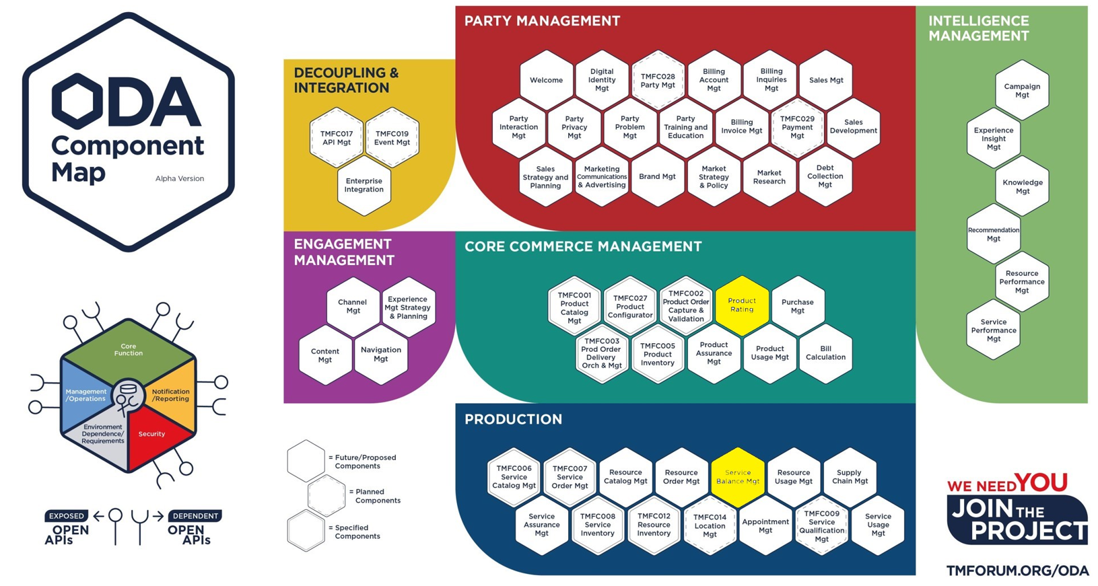
STL dPCC for Balance Management
Modules of dPCC

Slide 4
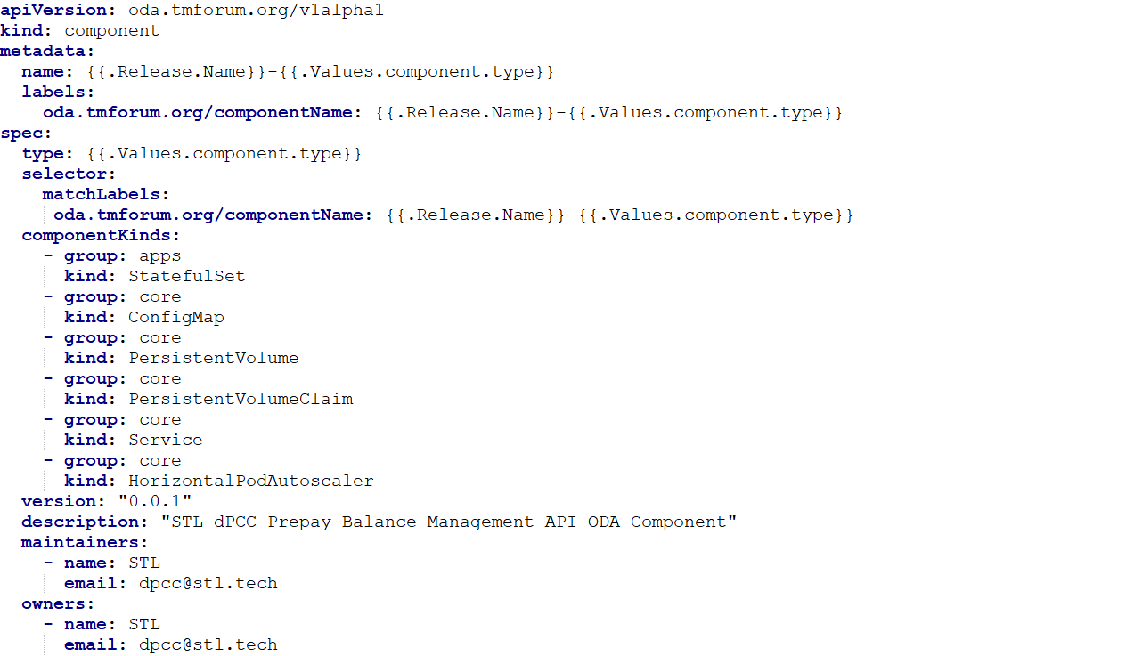
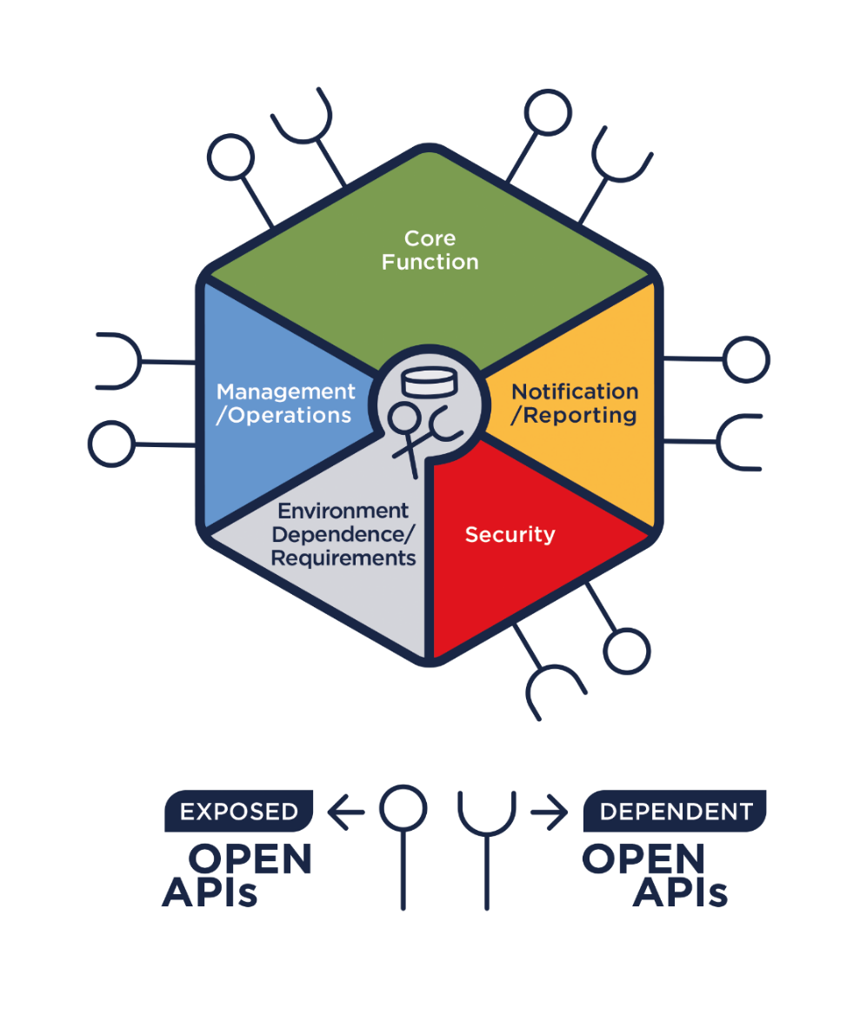
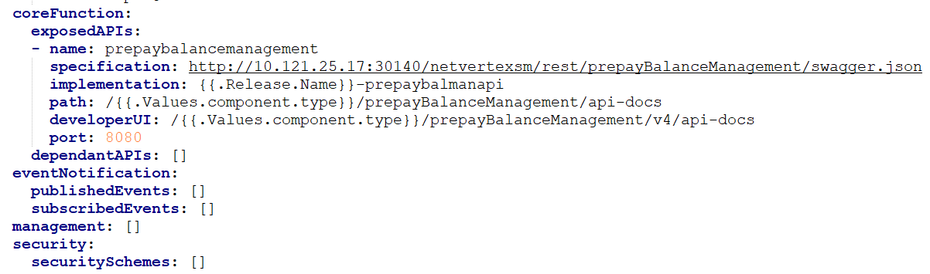
STL PCRF, PCF ODA Component Envelope
An ODA Component describes itself via its “Envelope” (YAML definition)
ODA comprises reusable, cloud native software components organized into loosely coupled domains
1
5
2
1
4
3
2
5
3
4

Slide 5




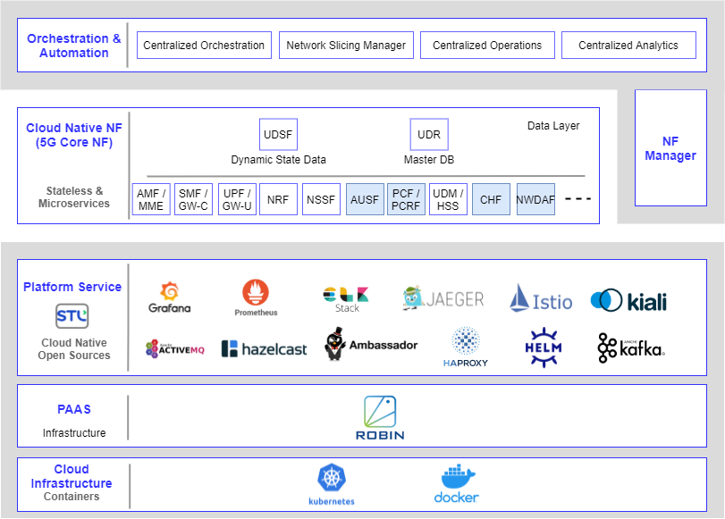













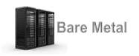








ODA Canvas on STL Cloud Native Platform
Run all your application workloads on STL CNP with ODA Canvas Kubernetes Operators
Application Workloads
Enterprise Applications
(Cloud Native Applications)
Digital MarketPlace
dBSS
SDN-NFV Applications
(CNFs)
API Manager
dPCRF
5G PCF
Intellza
IPLMS
dSP
dPCC
dWiFi
…
dMediation
CGF/CGNAT
5G CHF
…
BSS/OSS (CNFs)
Telco Network Applications (VNFs/CNFs)
Big Data / Data Analytics
Platform Services – STL CNP
CI/CD
Monitoring, Alerting, Logging, Tracing, Service Mesh, Messaging, Caching, IAM, Message Queues, Security, API GW, Load Balancer, Container Packaging, Container Registry Services
Component
Controller
Security
Controller
ODA Canvas Services
API
Controller
Component CRD
Webhook
PaaS – STL CNP
Kubernetes
Virtual Networking
App-workflow Manager
IaaS+
Private Cloud
Public Cloud
Any Virtualization
Virtual Private Cloud
IaaS
COTS Server

Slide 6
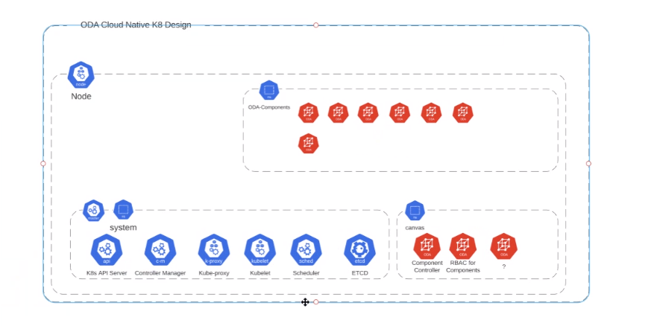


STL PCRF / PCF Deployment Model on ODA Canvas
ODA Functional Components
STL SM
STL
PCRF
STL PCF
STL SPR
STL UDR
STL CHF
STL OCS
STL Cloud Native Platform
Canvas
Canvas Services (non-functional)
Component
Controller
Component
CRD Webhook
API
Controller
Security
Controller
System
Notes:
SM = Server Manager for configuration of different components in dPCC.

Slide 7
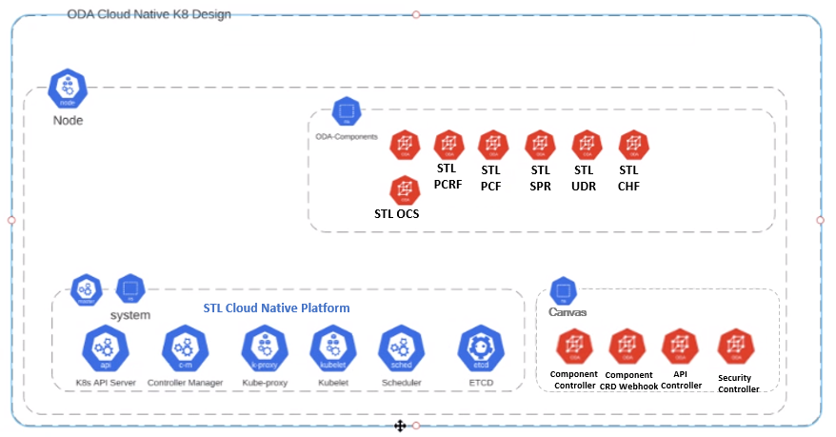
ODA Reference Implementation in the Open Digital Lab
Canvas
canvas-system
service-mesh-system*
Component Controller
Service Mesh (eg Istio)
Security Controller
Observability (eg Kiali)
API Controller
monitoring-system*
Canvas Services (non-functional)
Component CRD Webhook
Monitoring (eg Prometheus)
Visualization (eg Grafana)
api-gateway-system*
iam-system*
API Gateway (eg Whale Cloud, Apigate…)
Identity & Access (eg Keycloak)
Choice of implementation
Standard Canvas service
*namespace name may very depending on implementation

Slide 8
654 Prepay Balance Management (Top-up)
TMF and 3GPP Interworking
STL
dPCC
Top-up requestor
POST Top-up Balance
"/balancemanagement/v4/balanceTopups/top1“ (MSISDN, product, amount)
PCRF
PGW
654
Gx RAR
201 Success
Sy SNR
Gy RAR
3rd party
CRM/Portal
GET /balancemanagement/v4/buckets
654
OCS
P-CSCF
200 Success
Rx RAR
Common Notification platform
POST BalanceChangeNotification
654
SPR
External OCS

Slide 9
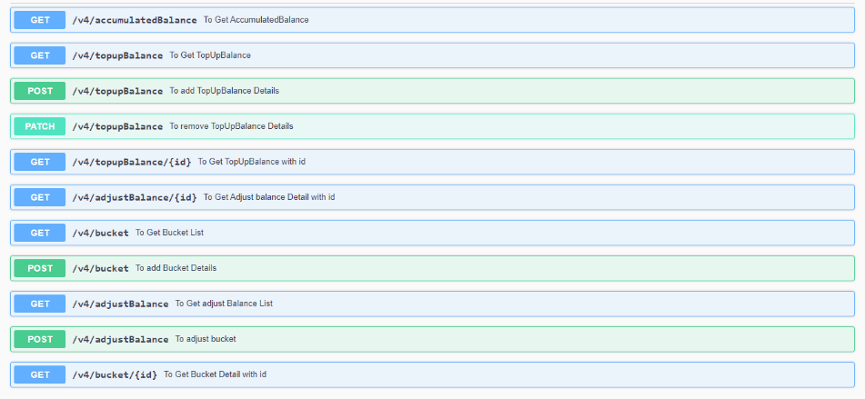
654 APIs - Prepay Balance Management
STL dPCC supported operations

Slide 10
Standalone – PCRF and PCF
SMF+PGW-C
PCF
UDR
5G Registration and PDU session
establishment using N7 SBI
5G sub latches on NR
When RAT is NR
gNB sends the registration request to AMF
AMF selects the PCF and SMF using NRF
SMF initiates Registration to PCF using N7
When RAT changes to UTRAN, SMF+PGW-C
selects a PCRF in the LTE network
maps 5G parameters to 4G AVPs
initiates 4G Diameter session with PCRF
Terminates the 5G session towards PCF
PCF uses subscriber’s 5G Policy Profile
in UDR
Apply Policies for 5G Session to SMF
SMF+PGW-C
PCRF
SPR
SMF maps 5G IEs to 4G
LTE EPS Bearer creation
using Diameter based Gx
5G sub moves to LTE
PCRF uses subscriber’s 4G Policy Profile
in SPR
SMF terminates session on 5G PCF
Apply Policies for 4G Session to SMF

Slide 11
STL Combo PCRF+PCF
SMF+PGW-C
STL PCF+PCRF
STL UDR+SPR
5G Registration and PDU session
establishment using N7 SBI
5G sub latches on to NR
When RAT is NR
gNB sends the registration request to AMF
AMF selects the PCF and SMF using NRF
SMF initiates Session Creation to PCF using N7
When the RAT changes to LTE, SMF+PGW-C
Triggers N7 Session Update service operation
Updates the RAT-Type to EUTRAN
No Diameter session with PCRF is initiated
PCF uses subscriber’s 5G Policy Profile
in UDR
Apply Policies for 5G Session to SMF
On detection of RAT-Type change
5G sub moves to LTE
Update the RAT Type using N7 SBI
Apply Policies for 4G Session to SMF

Slide 12
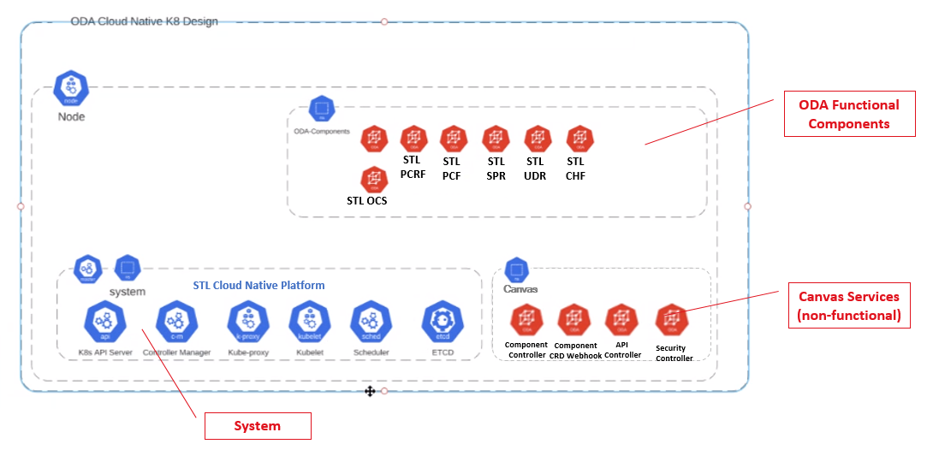
STL PCRF / PCF on ODA Canvas : Demo
Deployment of ODA Canvas on STL Cloud Native Platform
Deployment of STL PCRF / dPCC and STL PCF on ODA Canvas
dpcc-netvertex is the 4G PCRF deployment and 4gdpcc is generated from Helm Template
ODA Component Envelope definition for the deployment
TMFC013 Service Balance Management Golden Component (TMFC013 Definition in-progress currently)
TMF 654 Prepay Balance Management API as Exposed API
L1 Static Test and L2 Static Test for the deployment
PCRF / PCF UIs configurations on the ODA Canvas
Live 4G Diameter, 5G HTTP2 Traffic on ODA Canvas
Demo URL : https://drive.google.com/file/d/1XpW8SD9v-UGmqBcu-y5S40Yl7DxBmy6v/view

